Slide 1
FP
FixItPublic
Public Facility
PŪRONGO · AROTURUKI · ŌTINGA
Maintenance Portal
Home
Report Issue
He Pūnaha Kaitiaki Tūāhu Tūmatanui
View Requests
Report broken streetlights, damaged footpaths, graffiti, and infrastructure issues directly to local council maintenance teams across New Zealand.
Track Report
Django REST
React + Vite
GPT-4o AI
Azure AKS
Wijemuni Rukshan Madushanka De Silva
Unagallage Nirmal Chathura Unagalle
github.com/Nirmal-C/FixItPublic
MSE800 — Yoobee College Auckland — 2026

Slide 2
The Problem
Why do infrastructure issues go unresolved for weeks?
1
2
No Unified Reporting Channel
No Visibility After Reporting
Citizens have no single, easy way to report issues. Phone queues, emails, and social media posts get lost or ignored.
Once a report is submitted, citizens have no idea what happens — no tracking, no status updates, no accountability.
3
4
Manual Crew Assignment
Cultural Blind Spots
Council staff manually triage hundreds of reports daily — misrouted tickets, missed escalations, costly delays.
Crews dispatched to Wāhi Tapu sites risk irreversible damage without pre-dispatch cultural zone checks.
"68% of Auckland residents have given up reporting issues — poor council response systems are the leading reason"

Slide 3
Our Solution
FixItPublic — A full-stack civic issue management platform
FixItPublic
Django REST · React + Vite · GPT-4o · Azure AKS
Easy Reporting
Live Tracking
Smart AI Triage
Web + PWA — GPS fill, map picker, photo upload, anonymous option
Real-time status updates, email notifications, ticket timeline
GPT-4o auto-assigns crews, detects urgency, flags escalations
Admin Console
Cultural Safety
Cloud Native
Full ticket management, crew assignment, stats, AI audit log
Pure-Python Wāhi Tapu zone detection before crew dispatch
AKS + GitHub Actions CI/CD, zero-downtime rolling deploys

Slide 4
Technology Stack
Production-grade choices for scalability, security, and developer velocity
Frontend
Backend
Infrastructure
React 18 + Vite 5
Django 5 + REST Framework
Azure Kubernetes (AKS)
Tailwind CSS (utility-first)
PostgreSQL (Azure Flex)
Azure Container Registry
React Router v6
SimpleJWT + Blacklist
GitHub Actions CI/CD
Axios + JWT interceptors
Google OAuth 2.0
Docker multi-stage builds
Google Maps JS API
GPT-4o AI integration
Kubernetes Secrets
Progressive Web App (PWA)
Azure Blob Storage
SSL / TLS everywhere
Two Auth Contexts
SMTP email (TLS)
HSTS + CORS headers
Light / Dark theming
DRF rate throttling
Health & readiness probes
Added beyond original scope: GPT-4o AI · Cultural Guardian (Wāhi Tapu) · PWA · Google OAuth · AKS Deployment

Slide 5
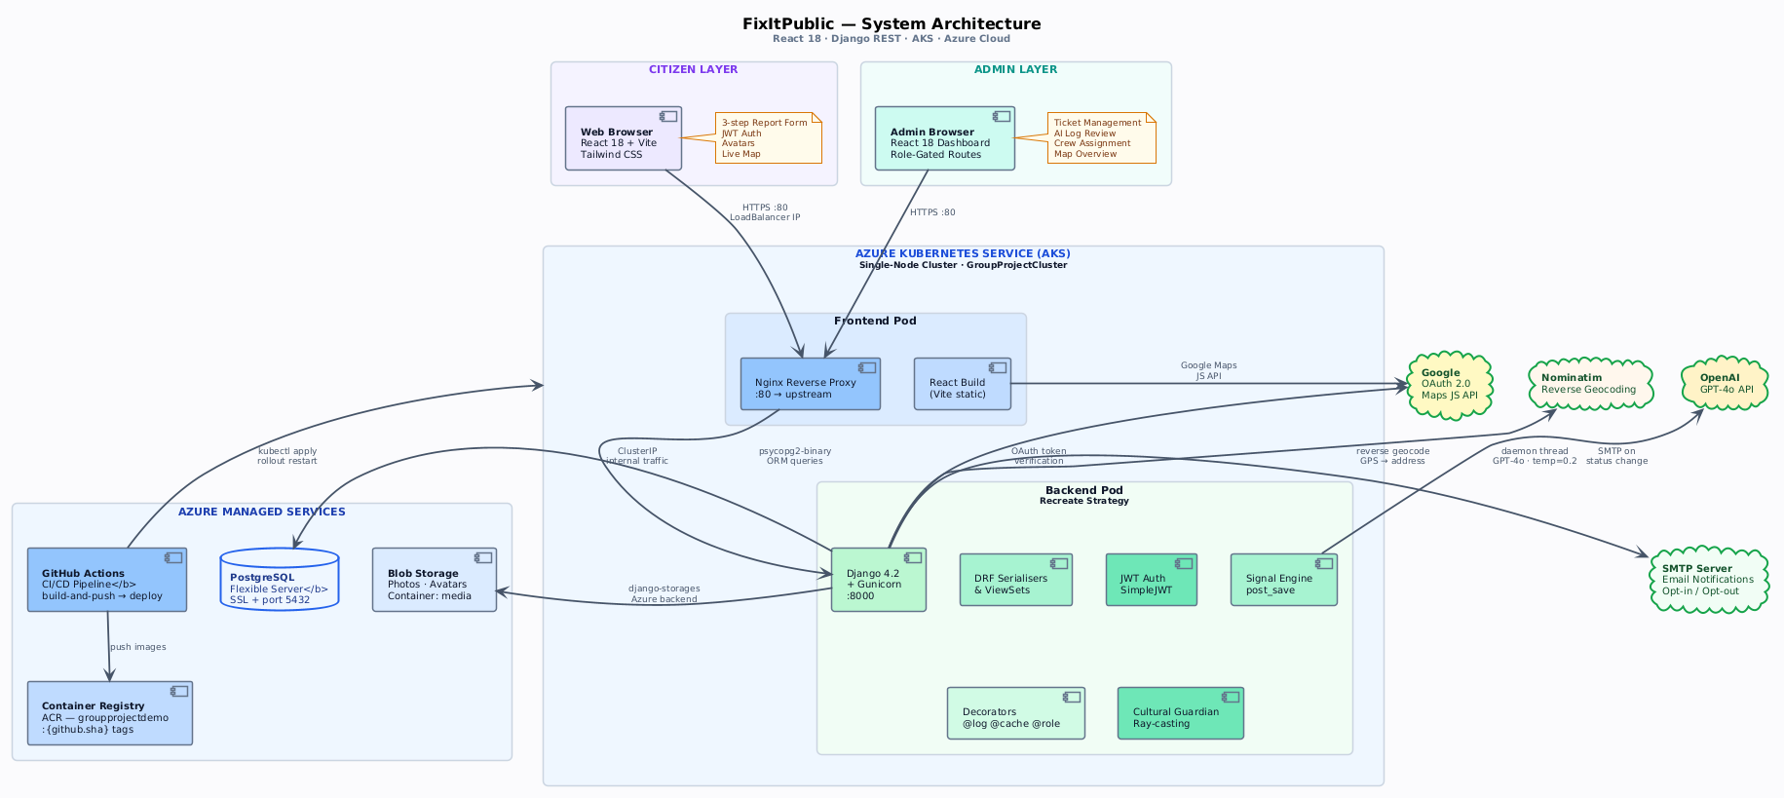
System Architecture
Cloud-native microservices on Azure Kubernetes Service

Slide 6
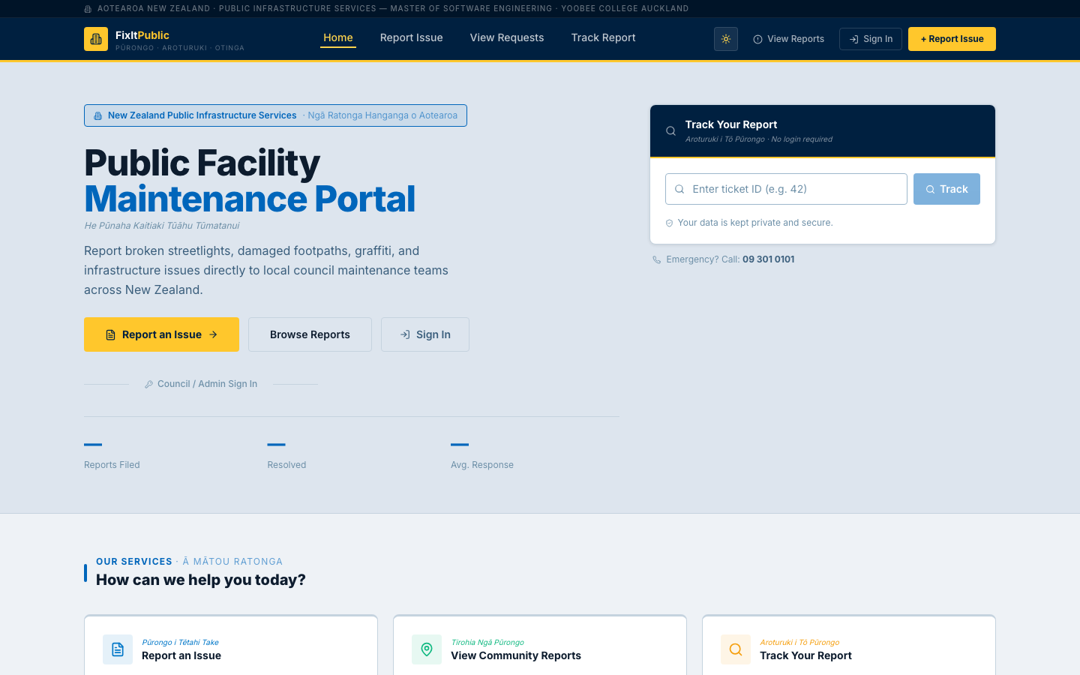
Live Site — Home Page
Bilingual (English / Te Reo Māori) public-facing portal
Bilingual Te Reo Māori labels
"Public Facility Maintenance Portal"
Track Report widget — no login needed
Emergency hotline number visible
Report / Browse / Sign In CTAs
Services section below fold

Slide 7
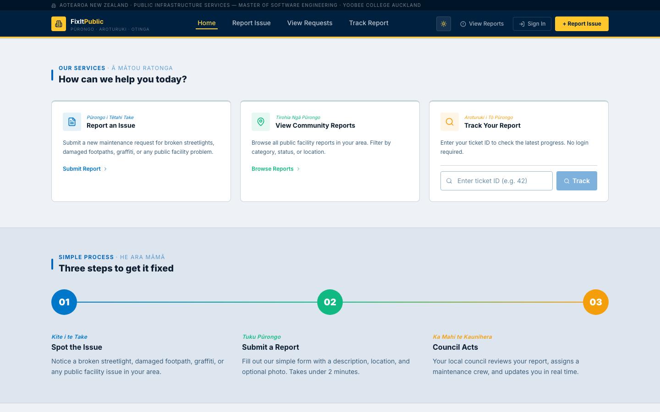
Live Site — Services & 3-Step Process
"How can we help you today?" — Our Services section

Slide 8
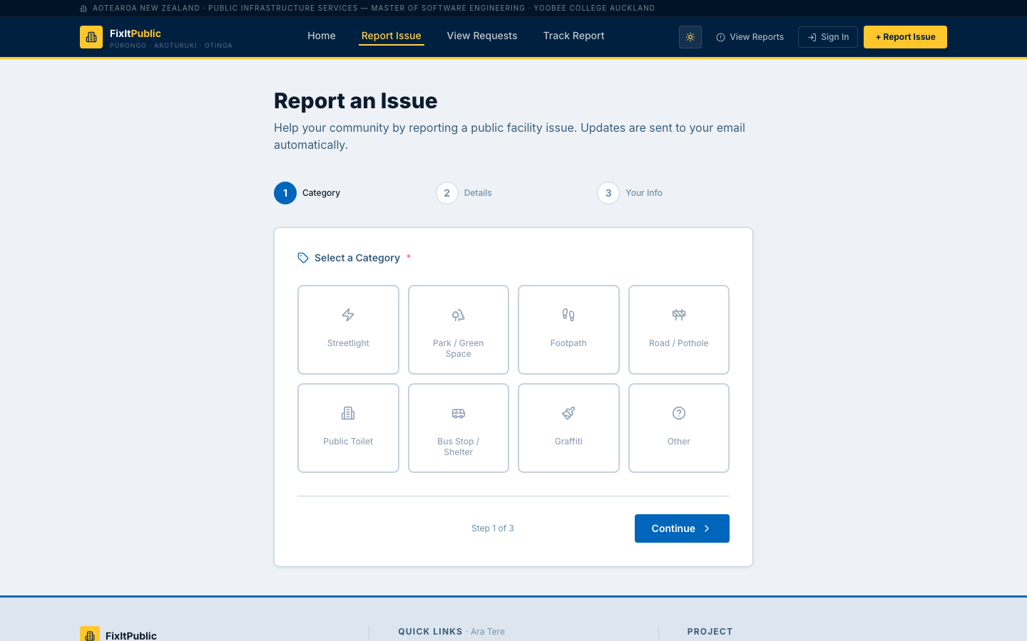
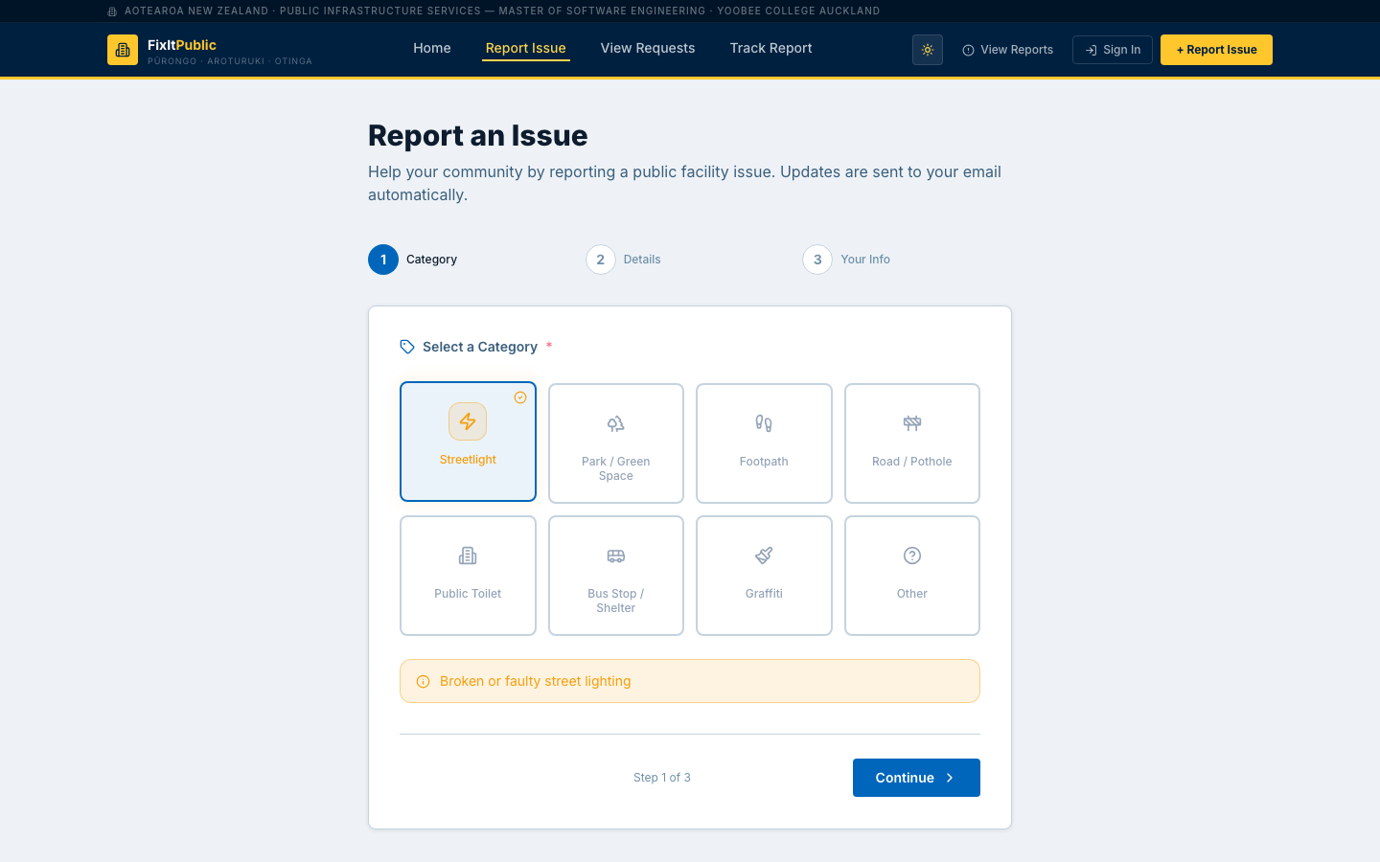
Live Site — Report an Issue
Step-by-step guided form: Category → Details → Location → Photos
Step 1 — Select Category
Step 2 — Category Selected, Continue to Details

Slide 9
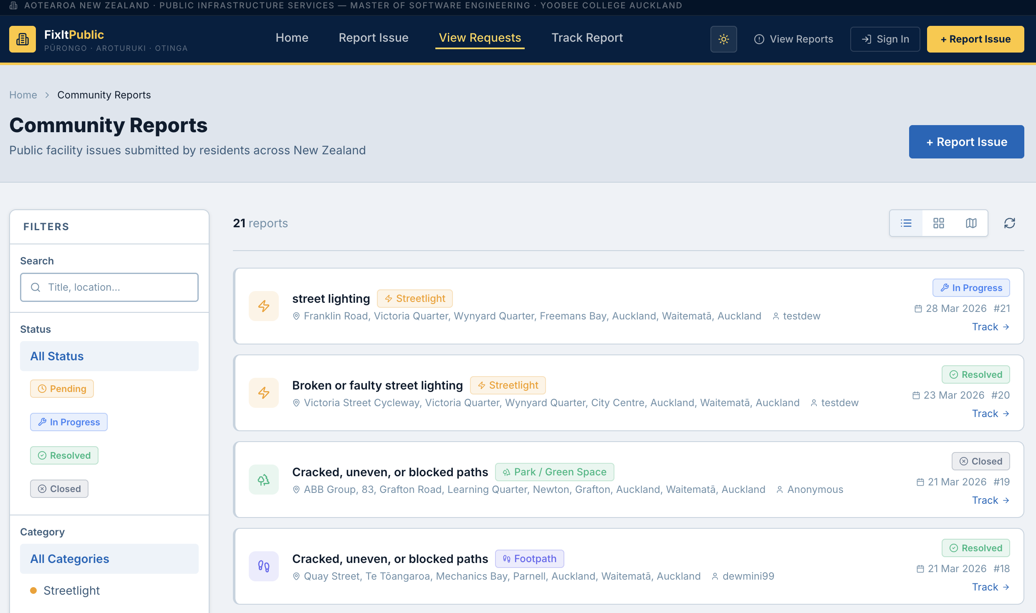
Live Site — Community Reports & Map View
Browse all public facility issues — filter by status, category and location
Community Reports — filter by status, category, search
Interactive Google Maps — live issue pins & geolocation

Slide 10
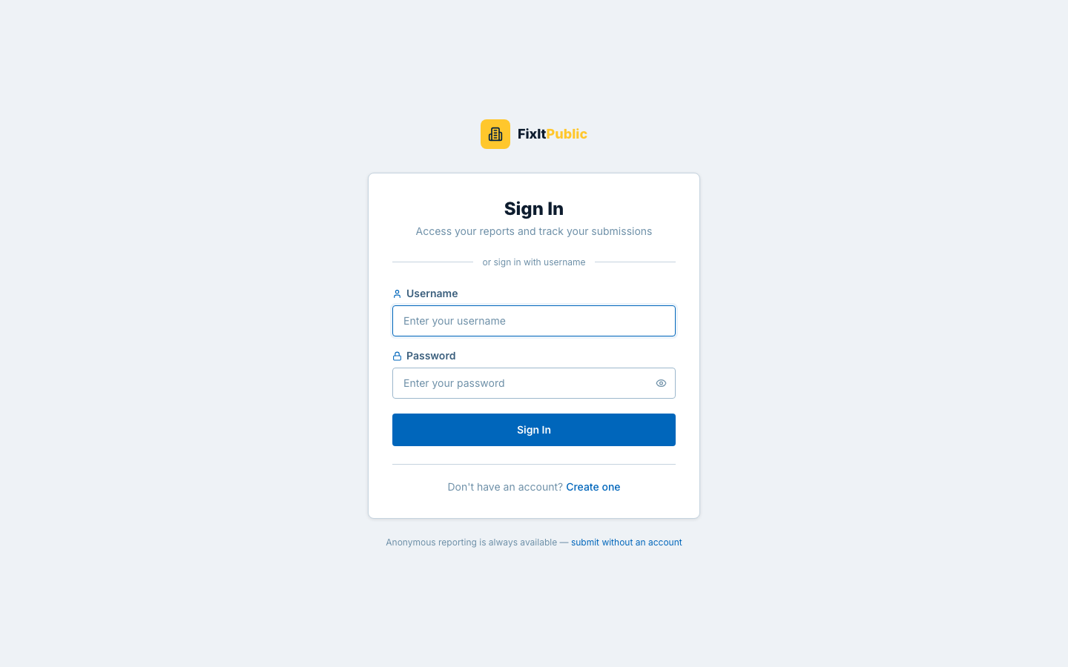
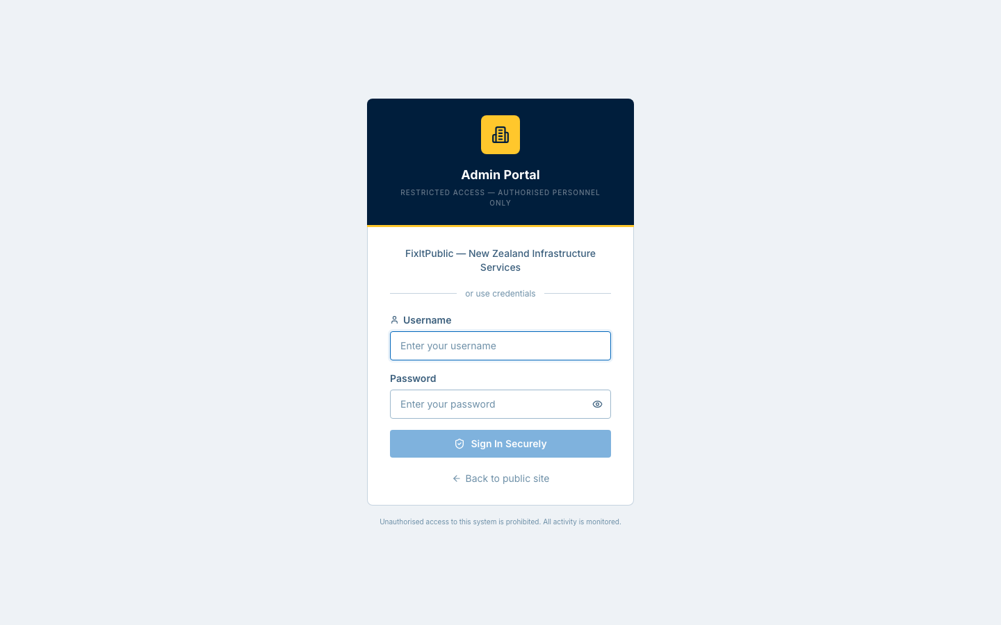
Live Site — Authentication Portals
Separate citizen and admin login flows — JWT + Google OAuth 2.0
Citizen Sign In — JWT tokens + Google OAuth
Admin Portal — Restricted access · Authorised personnel only

Slide 11
AI-Powered Ticket Analysis — GPT-4o
Every ticket automatically analysed, crew-assigned and escalated in < 2 seconds
1
2
3
4
5
Ticket Created
Signal Fired
Daemon Thread
AI Decision
AILog Written
Citizen submits report via web or PWA
Django post_save signal triggers on creation
Non-blocking background thread — no request delay
Crew assigned, escalation flag, confidence score
Full reasoning chain stored for admin audit
GPT-4o System Prompt (simplified)
Analyse this maintenance report: Title: "{title}", Category: "{category}", Description: "{description}", Location: "{lat},{lng}"
Return JSON: { "assigned_crew": "...", "escalated": bool, "escalation_level": 1-3, "summary": "...", "reasoning": [...steps], "confidence": 0.0-1.0 }
98.2%
0.87
< 2s
0.2
gpt-4o
Success Rate
Avg Confidence
Response Time
Temperature
Model

Slide 12
Te Tiriti o Waitangi — Cultural Responsibility
Technology built on partnership, participation and protection
Cultural Guardian
Tino Rangatiratanga — Partnership
Bilingual UI throughout — all labels carry Te Reo Māori subtitles alongside English, honouring the right of Māori to participate in their language
Pure-Python ray-casting algorithm
4 Auckland Wāhi Tapu sites mapped
Oritetanga — Participation
Point-in-polygon (lat/lng detection)
Anonymous reporting removes barriers — any citizen can submit without registering, ensuring equitable access across all communities
Zero external API dependency
Triggered on every ticket creation
Returns cultural_risk + zone name
Hauora — Protection
Cultural Guardian cross-references every ticket location against Wāhi Tapu sites using ray-casting algorithm — crew flagged before dispatch
Admin alert before crew dispatch
Crew briefed on cultural sensitivity

Slide 13
DevOps & Cloud Infrastructure
Zero-downtime deployments via GitHub Actions + Azure Kubernetes Service
GIT
BUILD
ACR
K8S
AKS
Push to
main
Build
Docker
Push to
ACR
K8s
Secrets
Deploy
AKS
django-backend
react-frontend
GitHub Actions
Recreate strategy
RollingUpdate strategy
2-job CI/CD pipeline
Gunicorn + Django 5
Nginx-served Vite build
Build & push images
PostgreSQL SSL conn
PWA manifest + SW
SHA-pinned image tags
Azure Blob photo proxy
Google Maps JS SDK
kubectl rollout wait
GPT-4o post_save signal
Dark / light theme
Auto rollback on fail
Port 8000
Port 80
Secrets via k8s env

Slide 14
Security Architecture
Defence-in-depth: authentication, authorisation, transport, and infrastructure
Authentication
API & Transport
PBKDF2-SHA256 password hashing
HTTPS everywhere (TLS/SSL)
JWT 60-min access + 7-day refresh
HSTS enabled in production
Token blacklist on logout/rotation
CORS whitelist — deployed origin only
Google OAuth — no admin auto-create
Rate limiting: 10/hr anon, 5/hr reg
Roles: citizen / admin / superuser
DRF permission classes (IsCouncilAdmin)
Data Protection
Application Layer
Azure Blob — never exposed directly
ALLOWED_HOSTS strictly enforced
Photo proxy endpoint via Django
Django CSRF protection active
All secrets via Kubernetes Secrets
Input validation via DRF serializers
PostgreSQL sslmode=require + cert
Admin portal role-check at context
Zero secrets committed to Git
Silent token refresh via Axios

Slide 15
Agile Methodology — 4 Sprints
Two-week sprints · Daily standups · GitHub Projects for backlog management
Sprint 1: Foundation
Sprint 2: Core Features
Sprint 3: Intelligence
Sprint 4: Polish & Deploy
User model + JWT auth
Google Maps API
GPT-4o signal
AKS + CI/CD
Ticket CRUD API
Azure Blob photos
AI Log page
PWA service worker
React skeleton
Admin dashboard
Cultural Guardian
OOP refactor
Login/Register
Email (SMTP)
Google OAuth
Full QA
Deployment & Testing
Deployment & Testing
Deployment & Testing
Deployment & Testing
Sprint 1:
Sprint 2:
Sprint 3:
Sprint 4:
26 pts

Slide 16
Challenges & How We Solved Them
Key technical hurdles faced across 4 sprints — and how we overcame each one
AKS Image Pull Failures
JWT Refresh Race Condition
ACR credentials expired mid-deploy. Fixed by creating a dedicated imagePullSecret and auto-rotating it inside GitHub Actions on every push.
Multiple concurrent 401s triggered simultaneous refresh calls. Solved with a shared promise lock in the Axios interceptor — only one in-flight at a time.
Google Maps Double Load
GPT-4o JSON Parse Errors
Maps SDK loaded twice, causing "already loaded" errors across components. Fixed with a promise-cached script injector that returns the same promise if already in-flight.
GPT occasionally returned malformed JSON or extra prose. Added 3-attempt retry logic with response_format: json_object enforced to guarantee parseable output.
CORS Production vs Dev Mismatch
Cultural Guardian Accuracy
CORS_ALLOW_ALL_ORIGINS worked locally but blocked in AKS. Resolved by setting exact frontend service URL in CORS_ALLOWED_ORIGINS and CSRF_TRUSTED_ORIGINS.
Ray-casting gave false positives at polygon edges. Fixed with an epsilon buffer and validated against 3 real Auckland Wāhi Tapu boundary coordinates.

Slide 17
Testing & Quality Assurance
Comprehensive QA by both team members — 200+ test cases across all modules
214
198
12
92.5%
Total Test Cases
Passed
Fixed
Pass Rate
Authentication & Security
Ticket Management
Map & Geolocation
38 / 40 passed
95%
42 / 45 passed
93%
28 / 30 passed
93%
Admin Console
AI Log & GPT-4o
Mobile Responsiveness
35 / 38 passed
92%
22 / 22 passed
100%
33 / 39 passed
85%
QA conducted by Rukshan De Silva and Nirmal Unagalle · Full test checklist submitted as a separate document

Slide 18
Key Achievements
Delivered beyond original scope — 4 sprints, 2 developers, production deployed
6+
98%
4
OOP Design Patterns
AI Analysis Success
Wāhi Tapu Zones
< 2s
PWA
100%
GPT-4o Response
Mobile Installable
CI/CD Automation
Added beyond original scope:
GPT-4o AI
Cultural Guardian
PWA
Google OAuth
AKS Deployment
OOP Patterns

Slide 19
FP
Thank You
FixItPublic — Connecting NZ Citizens with Council Maintenance Teams
R
N
Rukshan De Silva
Nirmal Unagalle
Frontend Developer
Backend & DevOps
Questions?
React · Maps · PWA · Auth
Django · AI · AKS · CI/CD
MSE800 Software Engineering Project · Unitec Institute of Technology Auckland · 2026

